Slide 1
Introduction to Flow Cytometry
Jacob Beal
iGEM Measurement Summer Webinar: Quantifying fluorescence and cell phenotypes with flow cytometry
July 21st, 2020

Slide 2
Reminder: picking your instrument
Today’s focus
 | Fluorimeter | Plate Reader | Flow Cytometer | Fluorescence Microscope
Throughput | Low | High | High | Low - High
Resolution | Population | Population | Single Cell | Subcellular
Time Series | Yes | Yes | No | Yes
Dynamic Range | 2-3 logs | 2-3 logs | 3-6 logs | 1-2 logs
# cells | n/a | n/a | High | Low
For more on fluorescence in general, see the first portion last week’s webinar

Slide 3
Why flow cytometry? Distributions Matter!
Are these two groups of cells the same?
But they've got the same mean fluorescence…?

Slide 4
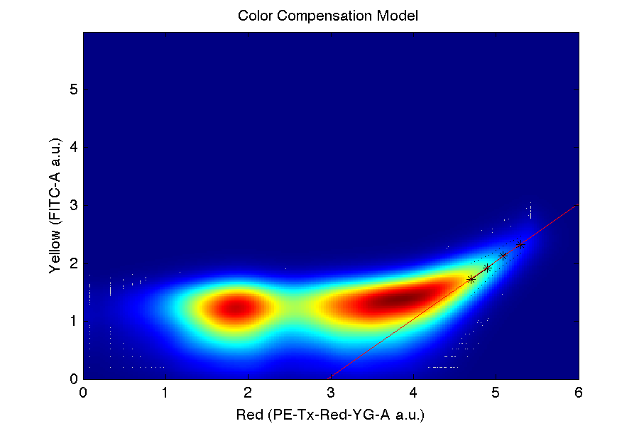
Per-cell measurements reveal variation
Example: RNA Replicon Cotransfection
Example: Constitutive mKate in HEK293
Quantization
Cell Variation
Dose Variation
Transfection
Efficiency
Autofluorescence
Spectral Bleed
Dose Efficiency
Dose/Resource Variation
[Beal et al., 2012]
[Beal et al., 2015]
Quantifying variation components requires large numbers of per-cell measurements.

Slide 5
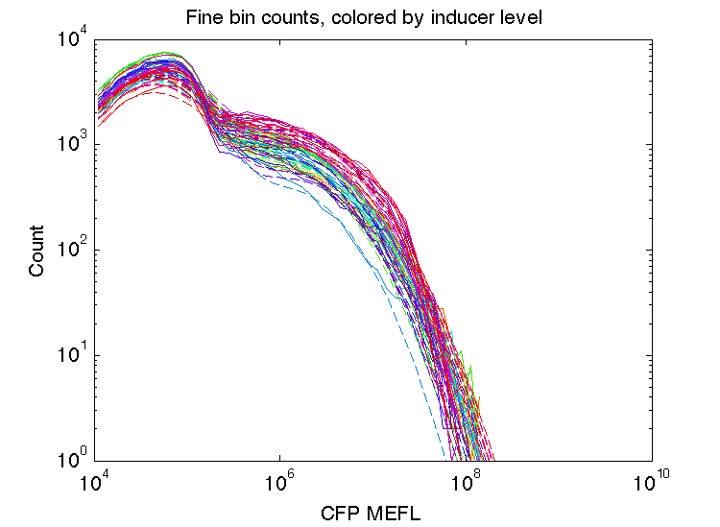
Distributions also help quality control
Bad Transfection
Good Samples
Bad Samples
Distribution Model
By modeling expected distributions, can detect failure of batches or individual samples

Slide 6
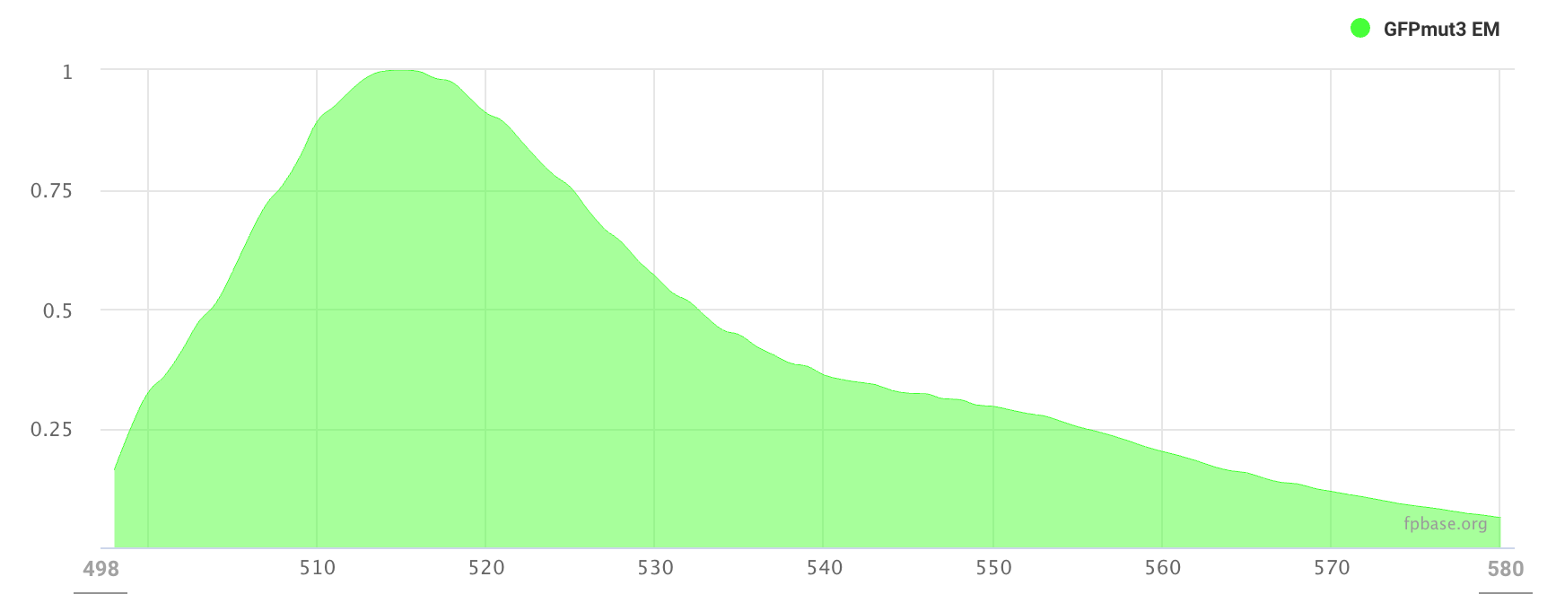
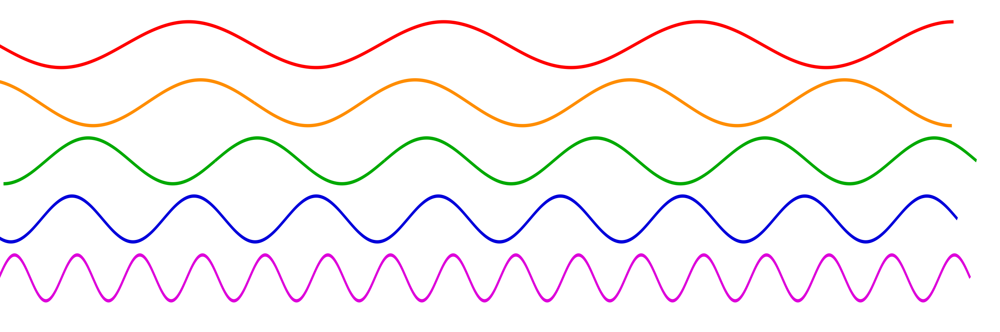
Reminder: Fluorescence Measurements
incoming excitation light
fluorescent
molecule
light emission at lower frequencies
Great signal, proportional to number of molecules
Exact unit relation in context is highly sensitive, hard to calculate
Molecule spectrum, brightness, folding, quenching
Sample pH, oxygenation, cell autofluorescence
Instrument excitation source, emission filters, detectors
Use proteins with good spectral separation

Slide 7
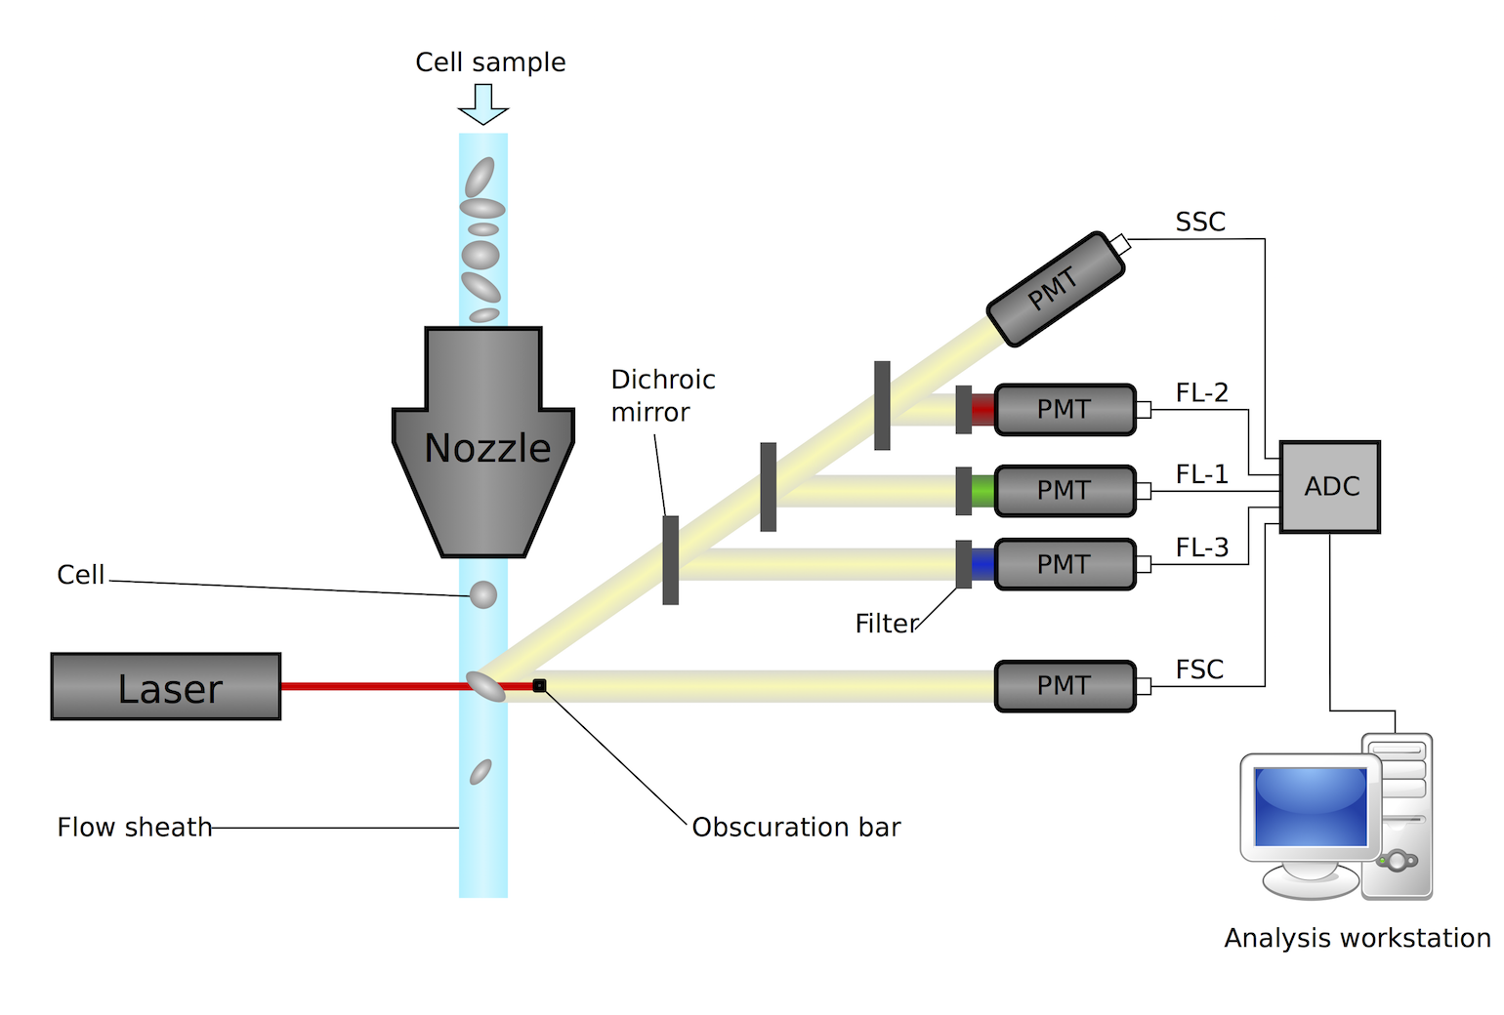
How Flow Cytometry Works
“granularity”
fluorescence
particle size
Instrument-specific challenges:
Lots of data points!
Individual cells behave (very) differently
Debris/pipetting contamination
Disruptive measurement

Slide 8
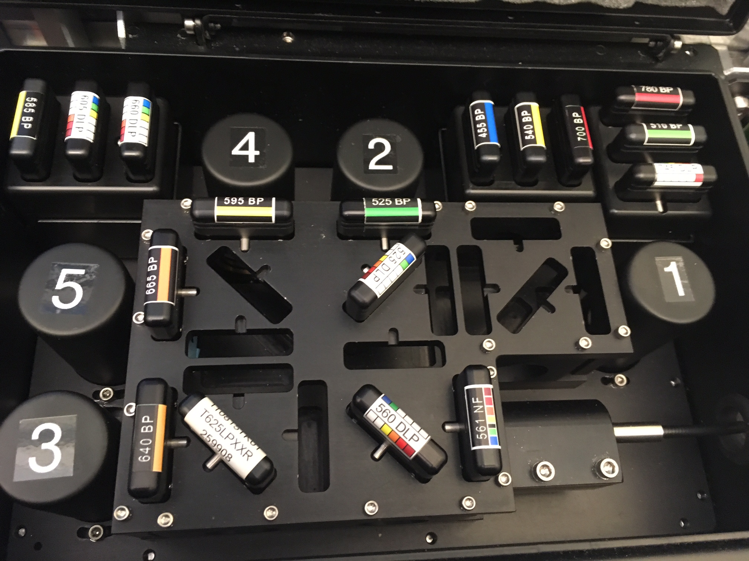
How Flow Cytometry Works
detector
filter
laser path
dichroic mirror
[Image courtesy of Sauro Lab, UW]

Slide 9
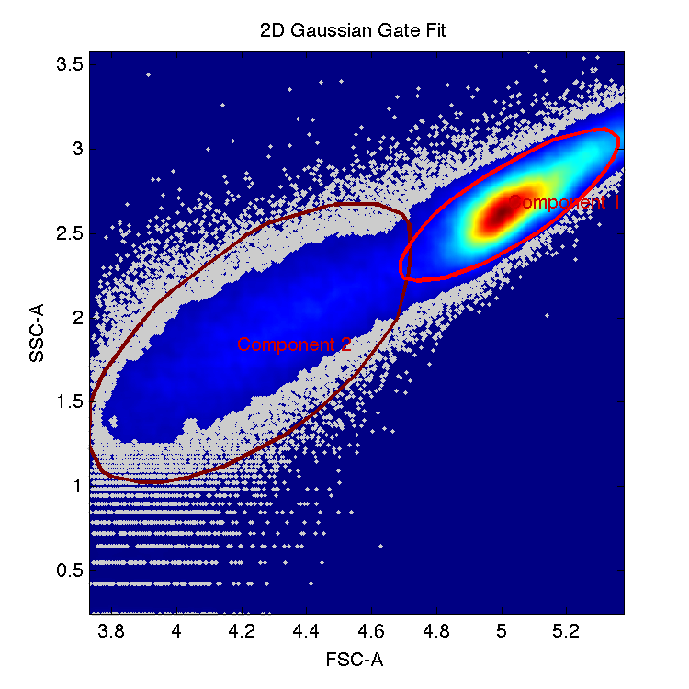
Many data points are not from cells!
probable cells
probable debris
“Gating” = filtering out debris, cell clumps, instrument contaminants, etc.

Slide 10
Area, Width, and Height
As a cell passes the laser, detectors register a pulse “event”
Most instruments report area, width, and (max) height
e.g., “FITC-A”, “FITC-W”, “FITC-H”
Area is proportional to total fluorescence
Width and height are flow-dependent, useful for gating doublets, debris, & clumps
Width
Intensity
Height
Area
Time

Slide 11
Internal Instrument Gating
Most instruments allow internal gating, to record only some events
Mostly avoid this: better to filter out extra events than wish you hadn’t lost data
Use only a conservative forward scatter (particle size) trigger
Too low → non-cell events overwhelm recording capability, cell events randomly dropped
Too high → cell events dropped
✓
✓
✓
FSC-A Intensity
trigger threshold
Time

Slide 12
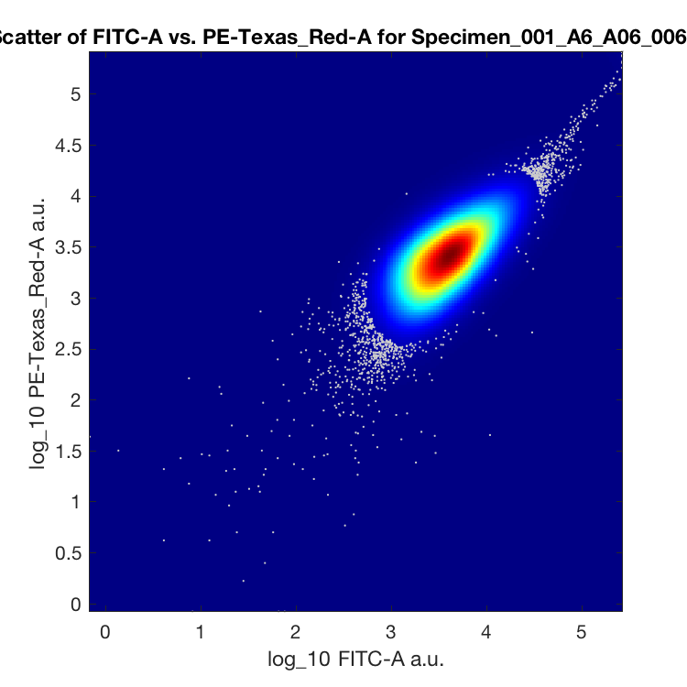
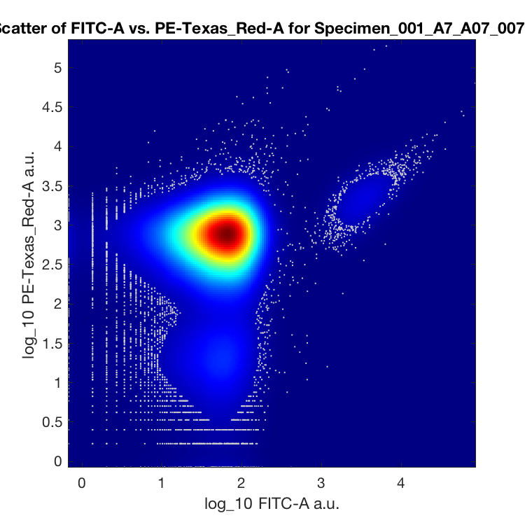
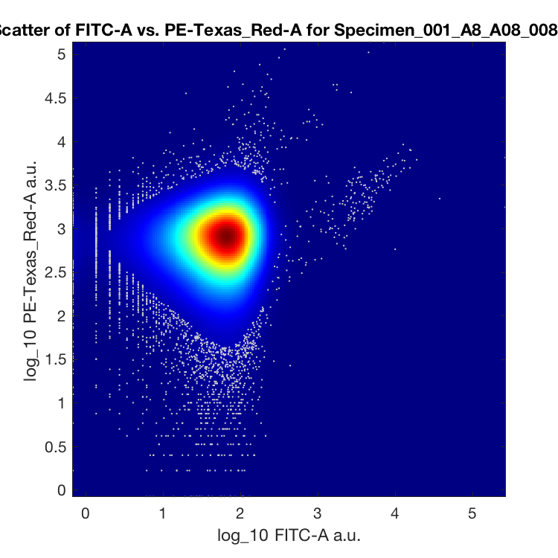
Cell Size vs. Flow Cytometers
Most flow cytometers were designed for human cells (~10um)
Too small: bacteria aren’t always fully cleaned out
Can add extra “wash wells” between experimental samples
Too large: muscle cells, neurons will clog the cytometer nozzle
Can use nuclear localization and extract nuclei
And remember to ask if your cells are allowed on the machine at all!
Contamination
from A6!
Well A6
Well A7
Well A8
[Data taken by Traci Haddock-Angelli in 2013]

Slide 13
Summary
Flow cytometry produces large volumes of single-cell measurements
Distributions of single-cell behavior reveal model parameters, protocol problems
Flow cytometers measure pulse area, width, and height on multiple channels
Forward scatter indicates particle area
Flourescence is best measured with area
Width and height are useful for gating
Beware well-to-well contamination with small cells (e.g., bacteria)

Slide 14
Calibrating and Checking Flow Cytometry Data with TASBE Flow Analytics
Jacob Beal
iGEM Measurement Summer Webinar: Quantifying fluorescence and cell phenotypes with flow cytometry
July 21st, 2020

Slide 15
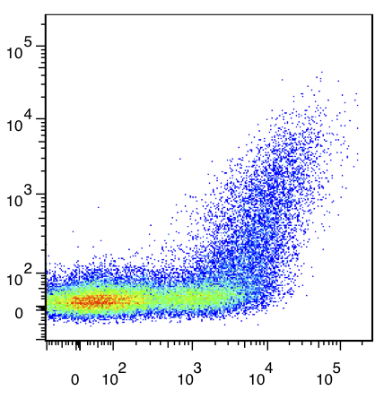
Metrology vs. Flow Cytometry
Flow cytometry is great for per-cell measurements, but…
Arbitrary unit output depends on…
Instrument brand, configuration
Interference from other colors
Choice of instrument settings
Run-to-run calibration drift
These are not
physical units!
Blue (Arbitrary Units)
Fortunately, this can be corrected…
Yellow (Arbitrary Units)

Slide 16

Calibrated Flow Cytometry
Calibration with standard materials:
MEFL units from NIST-certified rainbow beads
Background subtraction w. WT/NT
Spectral compensation w. single positives
Color comparison w. multi-color controls
Highly replicable measurements (~1.2x std.)
Multiple free & open software packages:
TASBE Flow Analytics (BBN)
CytoFlow (MIT)
FlowCal (Rice)
https://github.com/TASBE/TASBEFlowAnalytics
[Roederer, ‘02; Wang et al., ‘08; NIST/ISAC, ‘12; Beal et al., ‘12; Castillo-Hair et al., ’16; Beal et al.,’19]

Slide 17
Gating out non-cell / dubious events
Use your negative control for this
Usually better to throw away some cells than keep trash

Slide 18
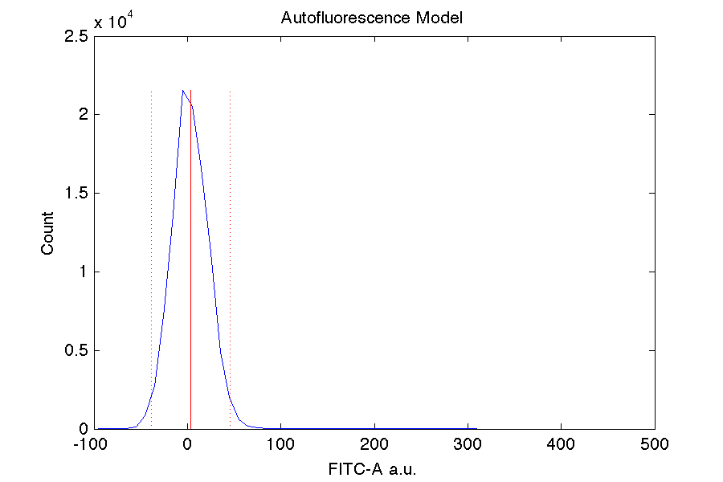
Compensating for Autofluorescence
Use your negative control for this

Slide 19
Compensating for Spectral Overlap
Use a strong positive control for each color
Note: only linear when autofluorescence subtracted
[cf. Roederer 2002]

Slide 20
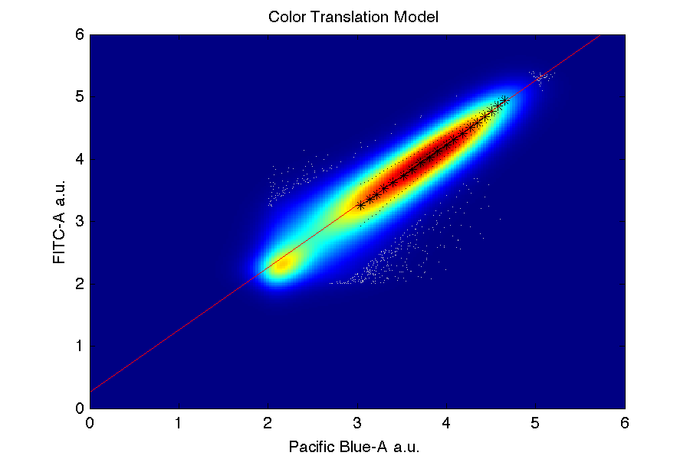
Translating Other Fluorescence to MEFL
Only FITC channel (e.g. GFP) goes directly
Others obtained from triple/dual constitutive controls
Must have exact same constitutive promoter!
Must have a FITC control protein!
This is a new control that you need to add

Slide 21
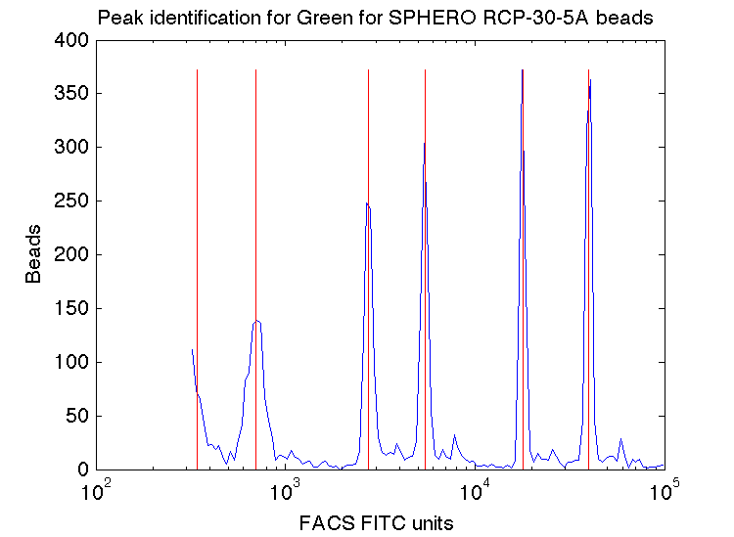
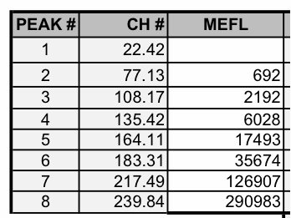
Fluorescent Beads → Absolute Units
SpheroTech RCP-30-5A
Run beads every time: flow cytometers drift up to at least 20 percent!
Also can detect instrument problems, mistakes in settings

Slide 22
Result: Distributions in MEFL Units

Slide 23
Cell Size Estimation
Forward scatter (FSC-A) can be calibrated to estimate diameter with sized beads
Relationship is systematic, but nonlinear!

Slide 24
Summary
Flow cytometry data needs to be calibrated in a multi-stage process:
Gating to remove clumps and debris
Subtract autofluorescence to remove background
Linear transformation to remove spectral overlap
Mapping colors to equivalent units (if desired)
Conversion to equivalent fluorescent molecules via known-fluorescence beads
Variable-size beads can calibrate forward scatter to estimate cell diameter
Free software packages are available (e.g., TASBE Flow Analytics)

Slide 25
Interpreting Flow Cytometry Data
Jacob Beal
iGEM Measurement Summer Webinar: Quantifying fluorescence and cell phenotypes with flow cytometry
July 21st, 2020

Slide 26
Reminder: geometric statistics
Use geometric statistics in analysis:
Strongest fraction may dominate population
Why geometric stats?
Complex catalytic reactions → multiply many rates:
R_{express} = R₁R₂R₃R₄R₅…
Central Limit Theorem → converge to log-normal!
Gamma distribution bursting also implies geometric stats
[Davidsohn et al., 2015], [Beal, 2017]

Slide 27
Reminder: Computing Geometric Statistics
Geometric statistics are just normal (arithmetic) statistics on a logarithmic scale:
Geometric mean = 10^(mean(log10(data)))
Geometric std.dev. = 10^(std(log10(data)))
Consequences:
Error bars no longer “plus/minus”
Instead: k-fold “times/divide”
Example of geometric vs. arithmetic statistics on per-cell fluorescence data:

Slide 28
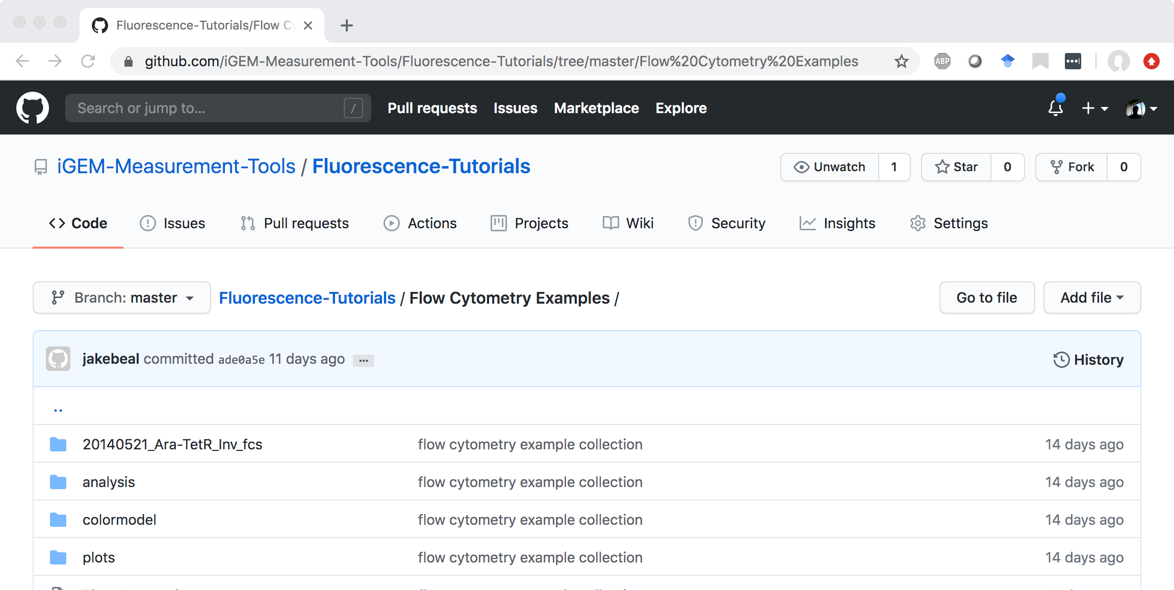
Example Data to Analyze
https://github.com/iGEM-Measurement-Tools/Fluorescence-Tutorials

Slide 29
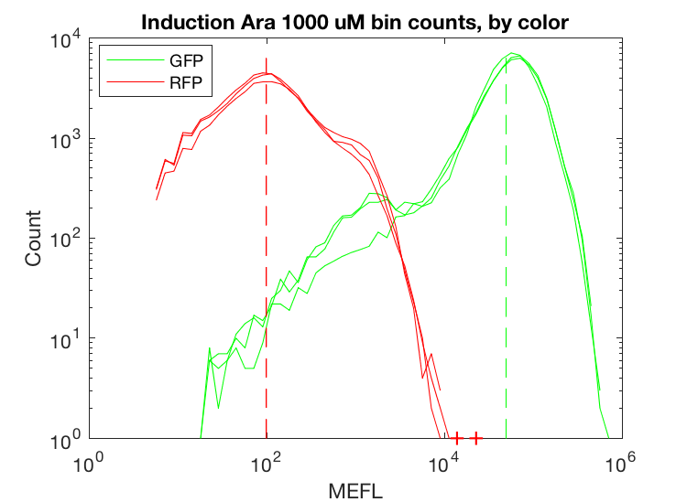
Arabinose-TetR circuit: Sample Analyses
Ara
AraC
GFP
TetR
RFP
pBAD
pBAD
pTet

Slide 30
Example Device Input/Output
Note: error bars show geometric standard deviation of per cell output, not across replicates

Slide 31
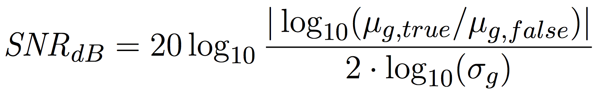
Signal-to-Noise Ratio
μ_{g} = geo. mean
σ_{g} = geo.std.dev.
“Off”
How well can we distinguish signals?
Out - In → ΔSNR
ΔSNR → Potential Circuit Depth
Signal
“On”
Noise
[Beal, Frontiers, 2015]

Slide 32
Example Device SNR
SNR = 5.7 dB
SNR = 0.0 dB
Interpretation: pBAD working well, TetR much less so.
TetR doesn’t seem to be turning on very strongly…

Slide 33
Summary
Use geometric statistics to summarize flow cytometry data
Consider distribution of single-cell behaviors
Signal-to-noise ratio helps assess device performance
Calibrated measurements help suggest approaches for improvement

